Slide 1


Am I
responsive?
Test me!
Galen Framework
Fernando Martín
Thursday, Oct. 29th

Slide 2






About me
Software QA engineer
Focus on automation
Tech lover
Social
http://fernando-martin.github.io
efemgy@gmail.com
https://www.linkedin.com/pub/fernando-mart%C3%ADn-gil/62/426/114
fer.martin33
https://github.com/fernando-martin

Slide 3
What am I showing today?
UI testing
What’s Galen?
Configuration
Galen Spec Language
Running tests
Reports
Demo

Slide 4


UI testing
Manually
What about RWD?

Slide 5

What’s Galen
Automated testing for responsive websites
Human readable
Basic and advanced syntax
Reports
JS and Java API
Selenium integration
and more ...
Notes:
Explicar cómo funciona: básicamente es hacer comprobaciones con los elementos de la interfaz, hay miles de comprobaciones: colocación, dimensiones, color, imágenes, texto…
And more: screeshots, Selenium Grid, Browser compatibility: chrome, safari, firefox, IE, PhantomJS, etc.

Slide 6
Configuration
Run this command in project directory
Properties
Range approximation
Custom listeners
Default browser
Selenium grid
Screenshots
$ galen config
Notes:
Range aproximation: approximation value for ranges when using "~" in galen page specs
Custom listeners: para reportes
Screenshots: fullPage, scrolls

Slide 7

Galen Spec Language
Object definition
HTML
<body> <div id='search-bar'> <input type='text' name='search' value=''/> <a href='#' class='search-button'>Search</a> </div> <ul id='menu'> <li><a href='#'>Home</a></li> <li><a href='#'>Blog</a></li> </ul> </body>
GALEN
@objects search-panel id search-bar search-panel-button css #search-bar a menu-item-* css #menu li a
Notes:
menu-item-*: sustituye por números según los elementos que haya (menu-item-1, menu-item-2, etc)

Slide 8
Galen Spec Language
Ranges
width 100px
width 50 to 200 px
width > 40 px
width < 40 px
width ~ 100 px
width 30 to 100 % of screen/width
Variables
Tagging and sections
= Main section = @on * menu: height 300 px @on desktop login-button: height 40 px
@set headerMargin 10 to 20px = Header = header-icon: inside header ${headerMargin} top left
Notes:
Ranges: para definir dimensiones de objetos. Screen: objeto especial definido en Galen, dimensiones del contenido (sin contar barras de scroll). También viewport para elementos que no cambian con scroll
Tagging: on desktop, on mobile, on *, on mobile, desktop

Slide 9

Galen Spec Language
Object specs
near
below
above
left-of, right-of
inside
width
height
aligned
text
visible
centered
absent
contains
on
component
Frame support
count
color-scheme
Image
Notes:
near - checks that object is located near another object
below - checks that an element is located below other object
above - checks that an element is located above other object
left-of and right-of - checks that an element is located above other object
inside - checks that object is located inside another object
width - checks the width of object
height - checks the height of object
aligned - checks horizontal or vertical alignment of object with other objects on page
text - checks the text that is visible on page (is, starts, ends, contains, matches). Operations: lowercase y uppercase
centered - checks that object is centered inside another object
absent - checks that object is either missing on page or is not visible
contains - checks that object visually contains other objects inside it.
menu: contains menu-item-*
on - checks that object is visually located on other object
component - runs a subset of specs from another file within the given object context
color-scheme - checks the color distribution in the given object area

Slide 10



Galen Spec Language
Advanced object specs
Importing
Same spec to multiple objects
If statements
Loops
Warning level
Custom rules
Custom functions
Notes:
Custom rules: squared icon
Warning level: bug en web y queremos que no afecte al resultado del test
Custom functions: JS functions en los specs. Función en un script que se importa en .gspec (ejemplo: i18n)

Slide 11
Running tests
Single page test
Args:
url
javascript
include
exclude
size
htmlreport
testngreport
jsonreport
$ galen check specFile [args]
galen check homepage.gspec --url "http://example.com" --size "640x480" --include "mobile" --exclude "desktop" --htmlreport "htmlreport-dir"
Notes:
url - a URL of page for Galen to test on
javascript - a path for javascript file which Galen will inject in web page
include - a comma separated list of tags for spec sections which will be included in testing
exclude - a comma separated list of tags for spec sections to be excluded from the filtered group
size - dimensions of browser window. Consists of two numbers separated by “x” symbol
htmlreport - path to folder in which Galen should generate HTML reports
testngreport - path to xml file in which Galen should write TestNG report
jsonreport - path to folder in which Galen should generate JSON reports

Slide 12
Running tests
Test Suite
Args:
htmlreport
testngreport
parallel-tests
recursive
filter
$ galen test testSuite [args]
galen test mytest01.test --testngreport "report/testng.xml" --parallel-tests 4
Notes:
htmlreport - path to folder in which Galen should generate HTML reports
testngreport - path to xml file in which Galen should write TestNG report
parallel-tests - amount of threads for running tests in parallel
recursive - flag which is used in case you want to search for all .test files recursively in folder
filter - a filter for a test name

Slide 13
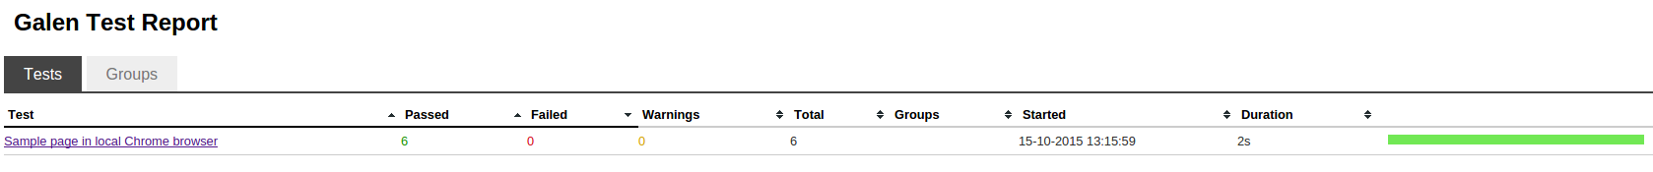
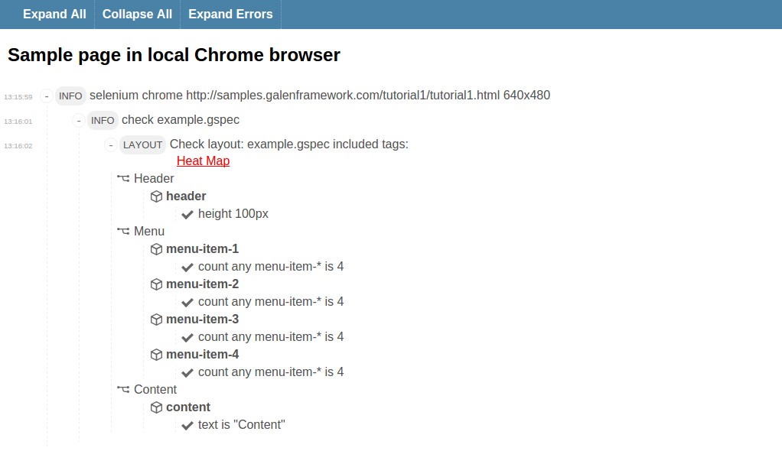
Reports
Notes:
HTML
TestNG sobre todo para CI

Slide 14


Slide 15
Resources
Official website, http://galenframework.com/
GitHub, https://github.com/galenframework
More examples, http://mindengine.net/category/galen/

Slide 16


QUESTIONS?

